Slide 1
Database Fundamentals Module 6: Basic Database Administration
Chris Randall and Graeme Malcolm

Slide 2
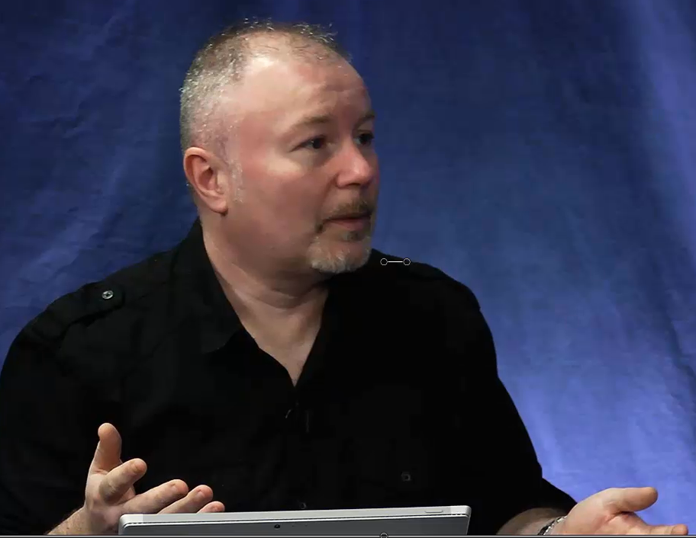
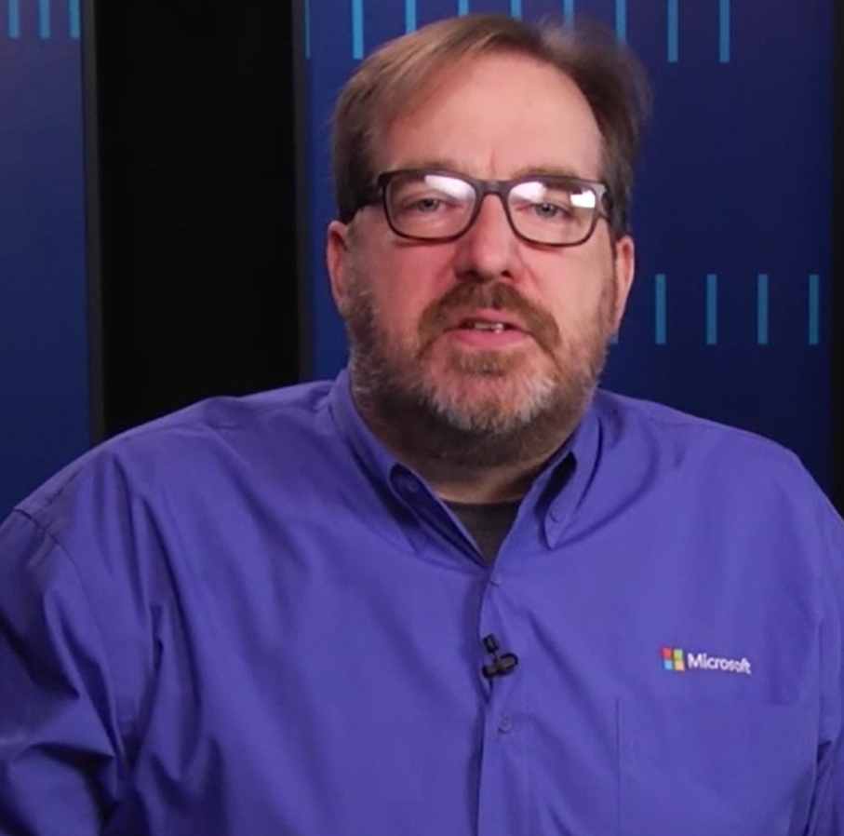
Welcome back! So what’s next Chris?
Well Graeme, now we’re going to talk about managing databases and servers

Slide 3
Installation and Configuration
Chris Randall and Graeme Malcolm

Slide 4
OS
Storage
Memory
Network
Edition
Features
Accounts
Settings
Notes:
THIS SLIDE IS ANIMATED – THE PRESENTER IS NOT
There are a number of things you need to prepare in order to successfully deploy a database server. Underneath the SQL Server application itself, you or your team will need to get a few things ready:
Click
What operating system will you use?
Click
Where will you store database files, log files, program files?
Click
How much memory do you think you need (now double it)
Click
How will your server communicate across the network? Through firewalls?
Click
Then there’s what’s needed to install SQL Server. At a very high level, you’ll need to choose an edition that supports your needs
Click
You’ll want to select the features - do you need to support SharePoint? BI services?
Click
You’ll need to provision accounts needed for the SQL services, as well as administrators
Click
You’ll also need to perform some post-installation configuration settings to ensure that the database server is running optimally

Slide 5
Installing SQL Server
Provisioning SQL Server in an Azure virtual machine

Slide 6
Backup and Recovery
Chris Randall and Graeme Malcolm

Slide 7
Full and partial database backups
Transaction log backups for point-in-time recovery
Back up locally or to the cloud
Notes:
Part of a DBA’s responsibilities include protecting databases from loss, either loss caused by user error, equipment failure, or disaster. In SQL Server, that’s handled primarily through backup and restore (although protection can also be implemented through various high-availability configurations).
Click

Slide 8
Backup and Restore
Backing up data and logs
Restoring to a point in time

Slide 9
Security
Chris Randall and Graeme Malcolm

Slide 10
Authentication
Authorization
Encryption
Auditing

Slide 11
Security
Adding users, creating permissions, encrypting databases

Slide 12
Monitoring and Maintenance
Chris Randall and Graeme Malcolm

Slide 13

Server and database health
Resource usage
Job execution
Validate backups
Tune indexes
Updates to OS and SQL Server
Notes:
Server and database health – memory capacity, disk space,
Are all of your SQL Server services running?
Did all of your SQL Agent Jobs run successfully?
Do you have a recent backup of all your SQL Server databases?
Are there any errors in your SQL Server Error Log?
Are you running out of space on any of your disks on your SQL Server?
Are you running low on server memory for SQL Server?

Slide 14
Monitoring and Maintenance
Monitoring database activity, rebuilding indexes

Slide 15
Install the edition of SQL Server that suits your needs
Configure disk usage, memory allocation, network support
Protect your data with regular backups, practice restoring
Control access and audit activity
Monitor database and resource usage, maintain indexes

